Slide 1
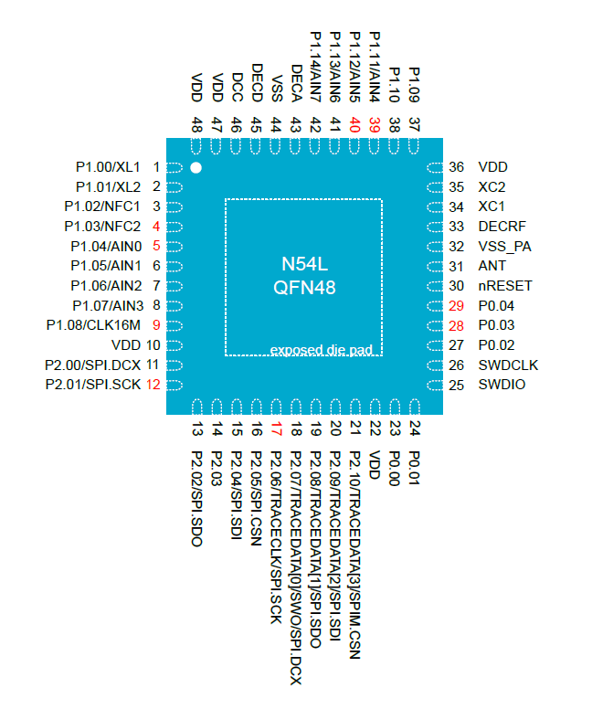
Analog reading of
voltage across battery
V_bat Input
From BMI323
I2C communication lines
SDA Line
SCL Line
INT2
From BMI323
INT1 and INT2 configurable
INT1
Charging LED indicators
D1 on top, D4 on bottom
D1 Toggle
D2 Toggle
D3 Toggle
D4 Toggle
From BQ24072RGTT
PGOOD on when charging complete
CHG on during charging
PGOOD
CHG
Note: Default I2C address of BMI 323 is 0x68

